Slide 1
History of Intel CPUs
By: Jashan Rai, Tawheed Bayaz, Salahuddin Ayoubi

Slide 2
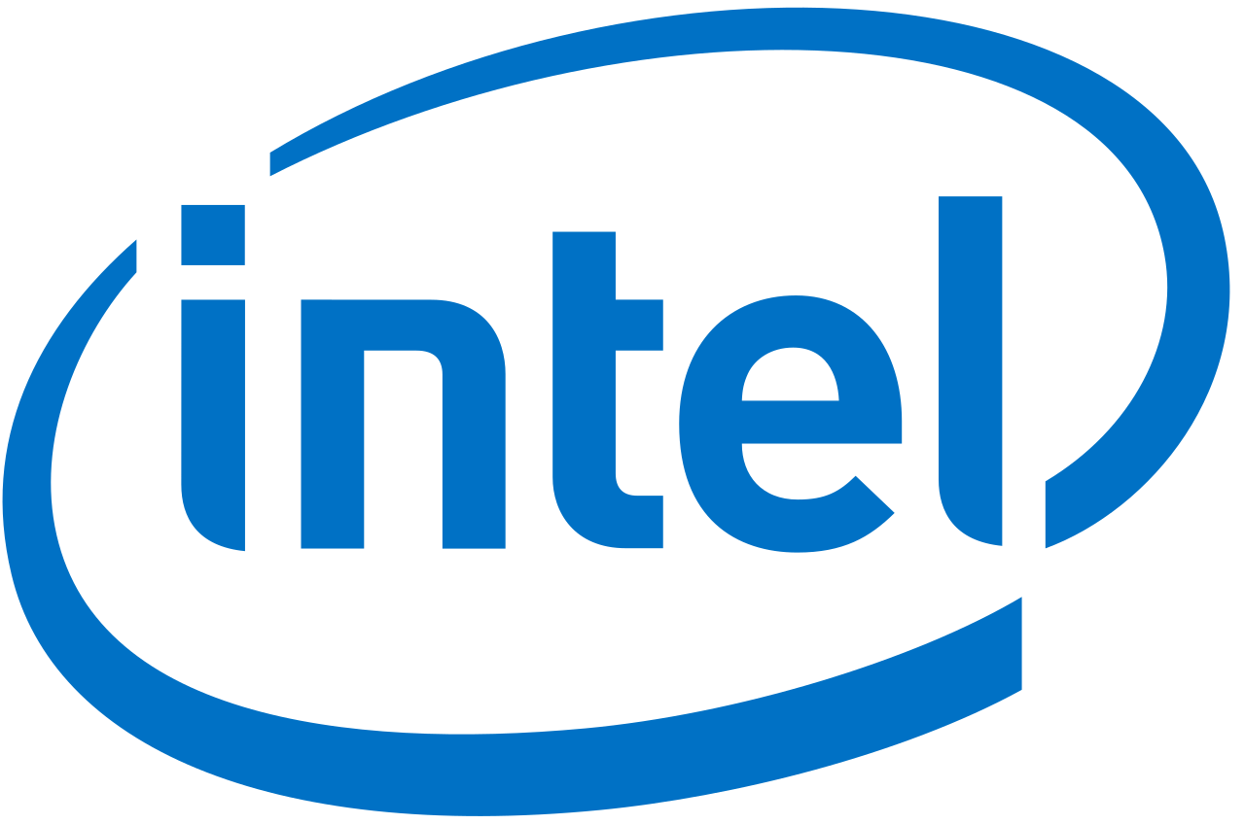
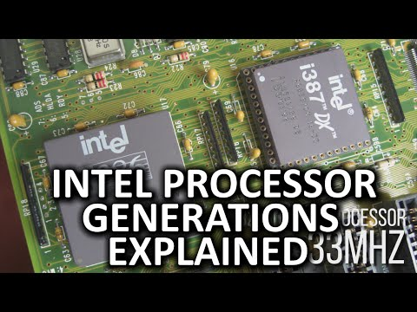
Video

Slide 3
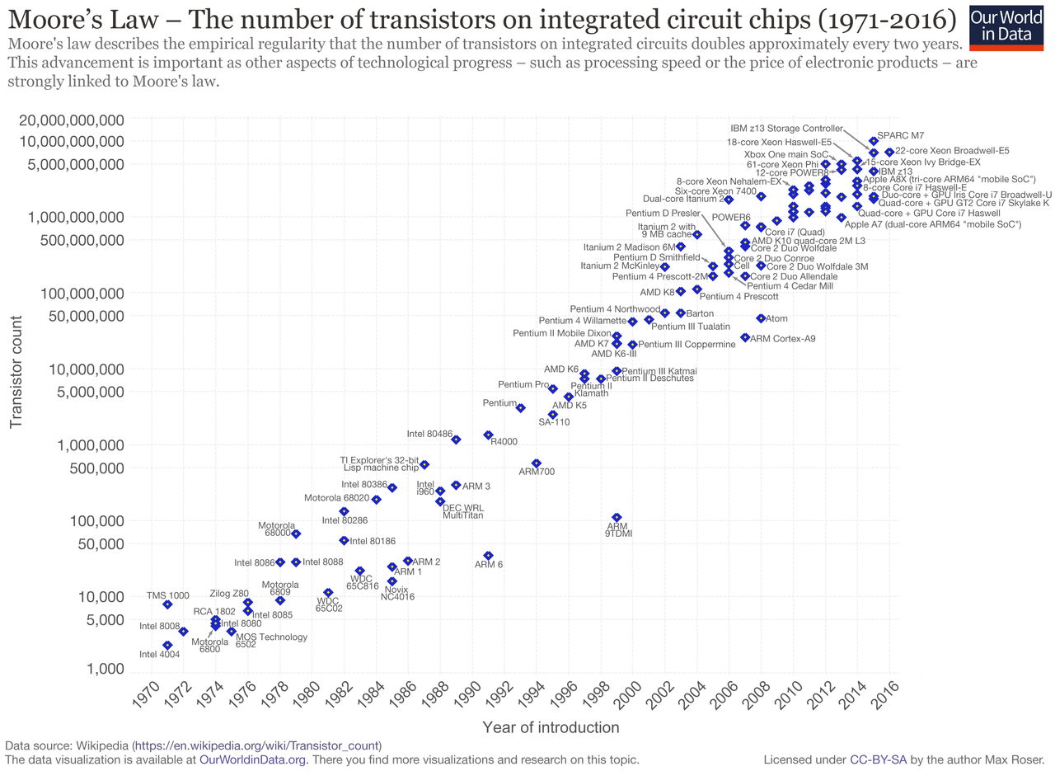
Moore's Law
That the number of transistors will double every two years
Gordon Moore wrote this in 1965 and expected it to last for a decade
It helped companies set long term goals and research development
It's not a law rather a observation of trends
It is dying however due to companies like Intel stuck at 14nm and rising costs for research

Slide 4
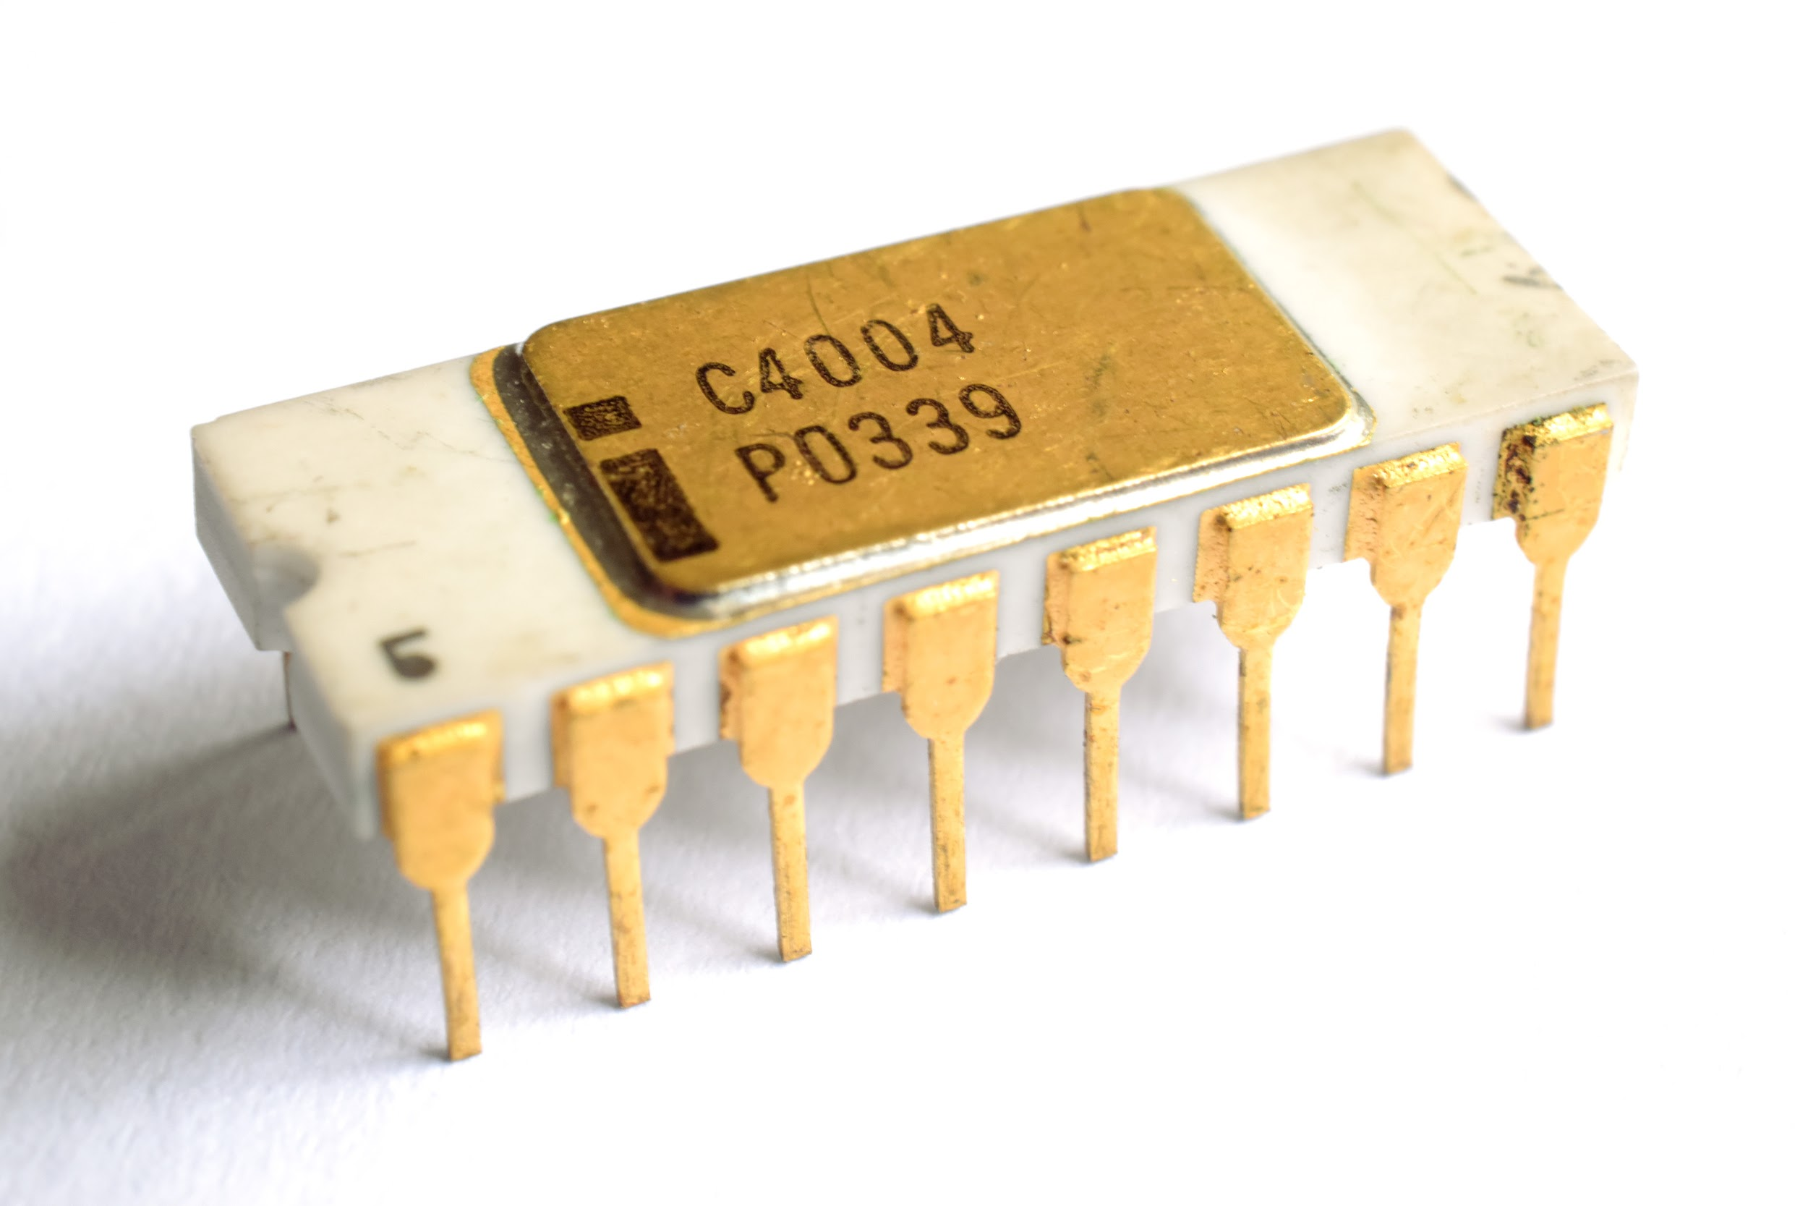
Intel 4004
Released in 1971 and was discontinued in 1981
Designed by Ted Hoff and Stanley Mozar
Breakthrough in Computer Science as it abe to fit server room performance onto a single die
Built on a 12 mm² die which packed 2,300 transistors
Clocked at 740 Hz and had a 4-bit bus

Slide 5
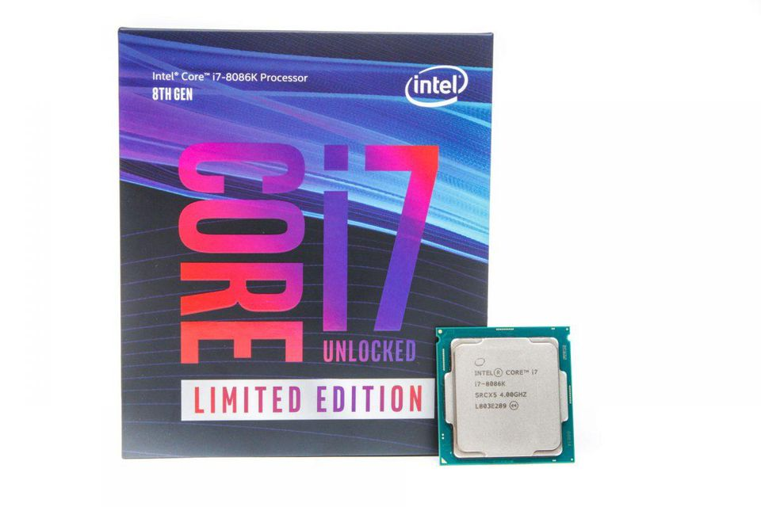
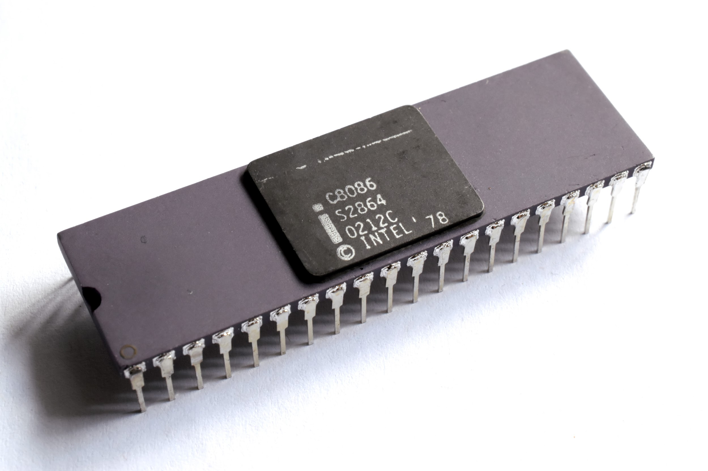
Intel 8086
Was released in 1978 by Intel
First 8 bit microprocessor
Uses Intel’s most popular x86, also used today
Clocked between 5 MHz to 10 MHz
Packed 29,000 transistors
It was in different versions and was discontinued in 1998
It also was celebrated in 2018 with the i7-8086k

Slide 6
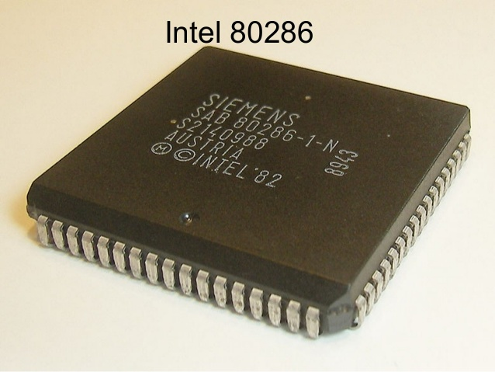
Intel 80286
Intel 80286 was first introduced to the industry on Feb 1st 1982.
It was first 8086 based CPU with separate non-multiplexed addresses as well as data buses.
The 80286 was reportedly measured to have a speed of about 0.21 instructions per clock on typical programs although it could be significantly faster on optimized code and in tight loops, as many instructions could execute in 2 clock cycles each.

Slide 7
Intel 80286
This CPU was designed for multi-user systems with multitasking applications, including communications such as automated PBXs and real-time process control.
The performance increase of this CPU vs the 8086 could be more than 100% per clock cycle in many programs.
The 80286 also included in addition to all of the 8086 instructions, all of the new instructions of the 8018.
However, memory cost and the initial rarity of software using the memory above 1 MB meant that 80286 computers were rarely shipped with more than one megabyte of RAM.

Slide 8
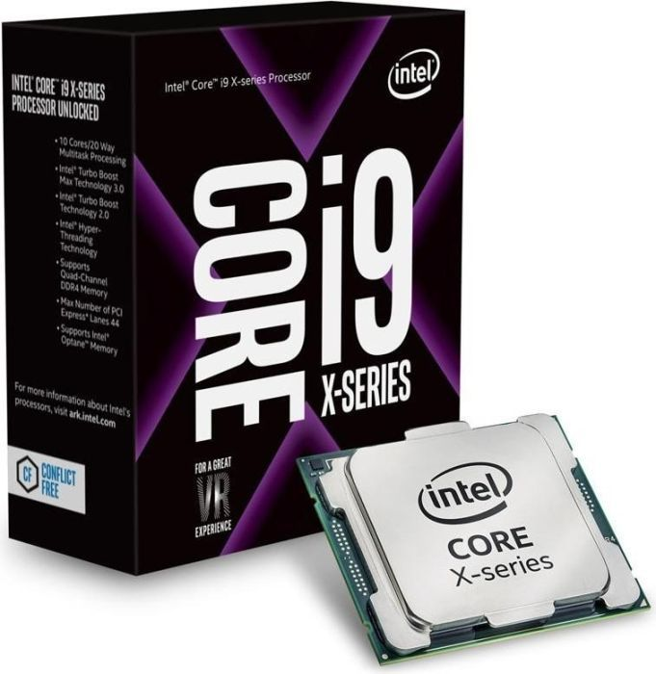
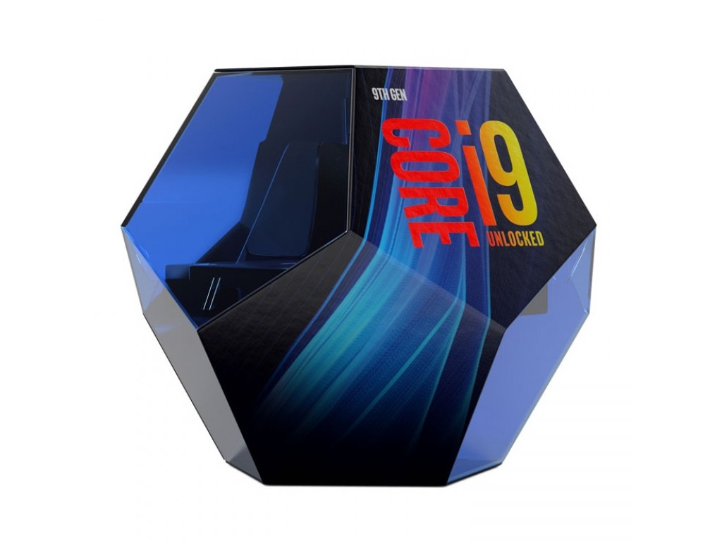
Intel Core i9
Core i9 first introduced in 2017, the Core i9 is Intel’s (and the world’s) fastest consumer processor yet.
It features four channels of DDR4 RAM and 44 lanes of PCI Express (compared with 28 in the i7).
introduces a new Turbo Boost, adds 4-channel DDR4 RAM, and Intel’s Optane Memory. Put together, this speeds up the whole performance.
The Core i9-9900K is set to cost $488, the i7-9700K will cost $373, and the i5-9600K will set you back $262.

